Slide 1


CS 767 Machine Learning
Mountain Car {Reinforcement Learning}

Slide 2

Content
Environment Info
Problem Statement
Concepts
Future Scope
Observation
Output

Slide 3
Mountain Car

Slide 4
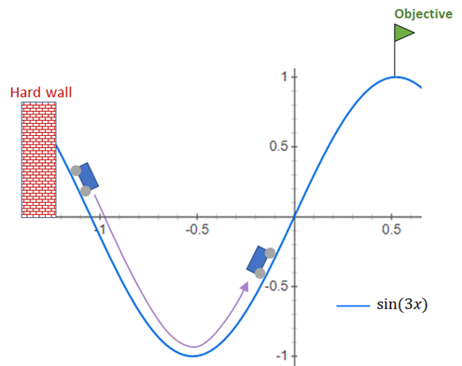
Environment Info
State space: Box
([-1.2 -0.07], ‘Lower’
[0.6 0.07] ‘Upper’
Action space:
Discrete(3)

Slide 5
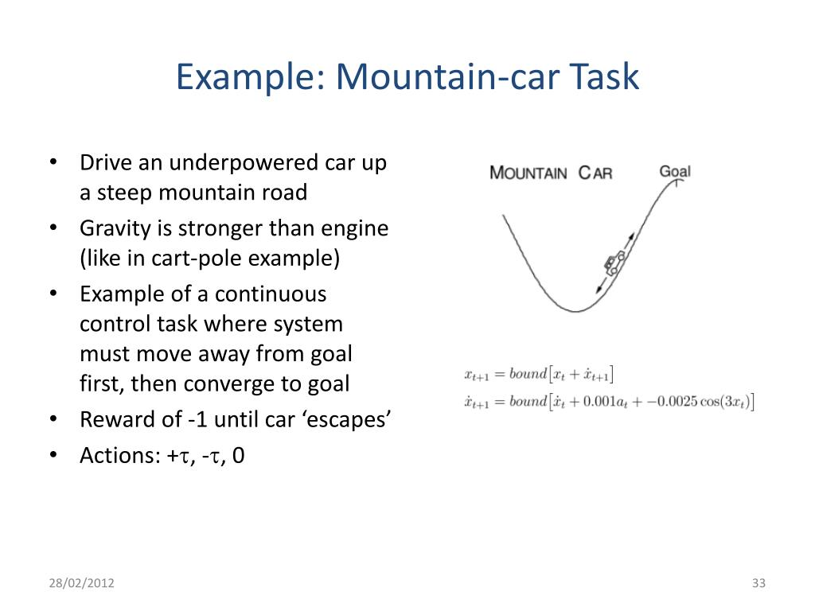
Problem Statement

Slide 6
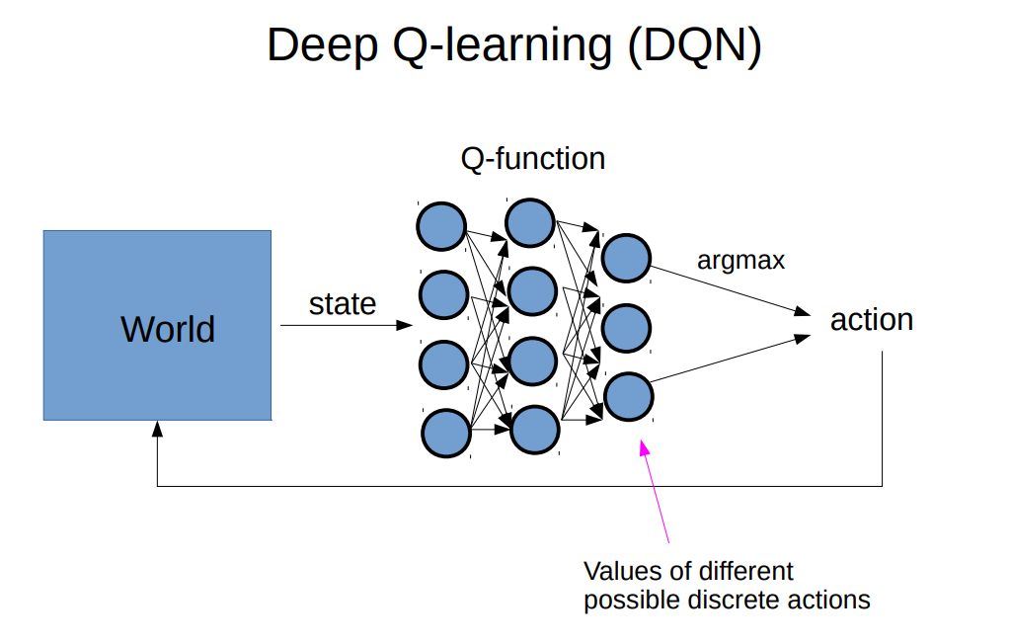
Concept
Q-function updates in DQN

Slide 7

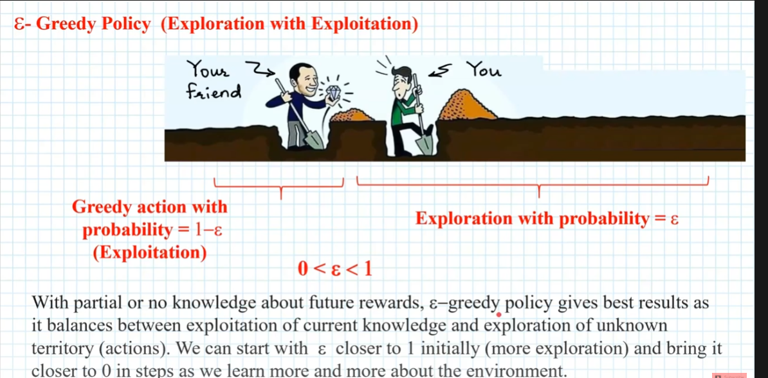
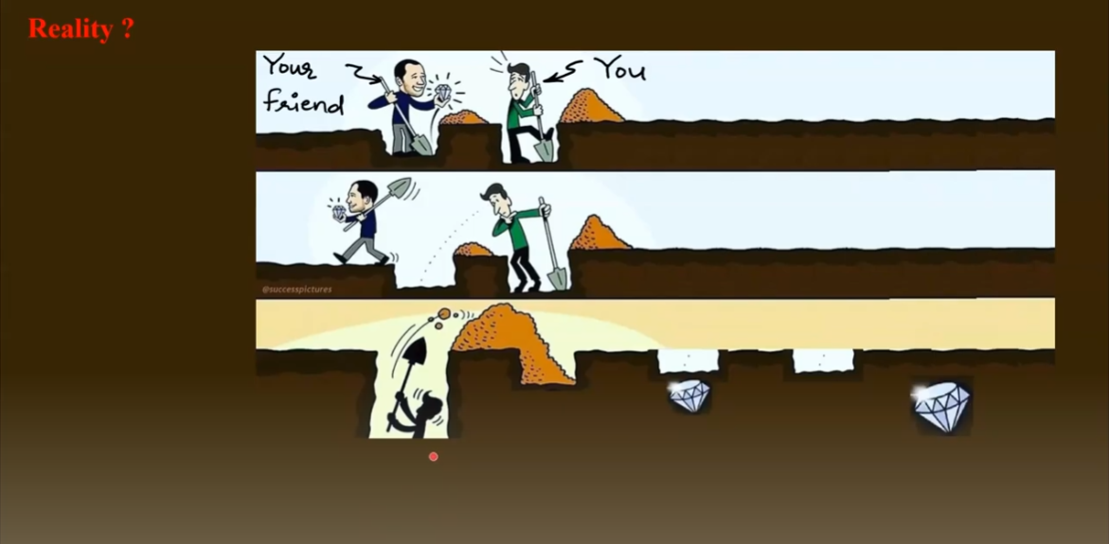
Concept
Linear Decay implemented

Slide 8
Observation
First success at episode in 30’s
The training was done in 6 minutes (RTX 3080 + CPU)
(After about 300 episodes the network converges.
Epsilon-Greedy Decay Algorithm
with Sequential model [SELU(Activation), ADAM (Optimizer), 4 layers]
Works the best
Rarely Fails in Testing

Slide 9

Future Scope
Same but Advanced algorithm can be used to define autonomous cars

